Slide 1

03.
Attitude Determination and Control Systems

Slide 2
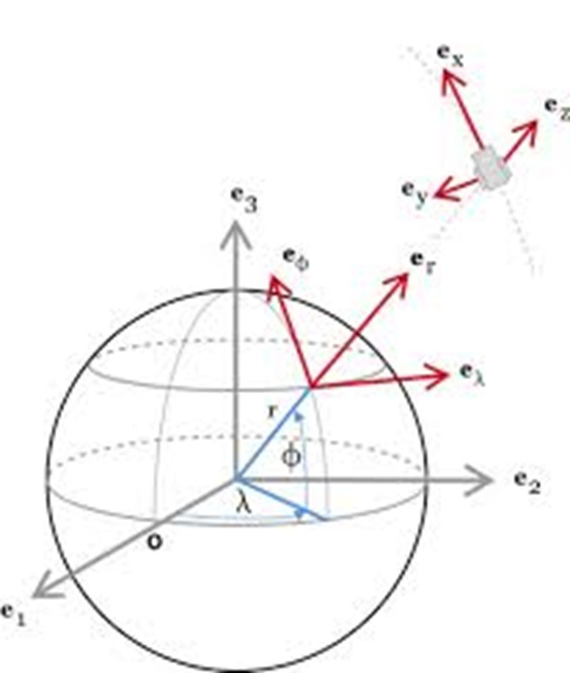
ALTITUDE?

Slide 3
ALTITUDE? ATTITUDE

Slide 4
CubeSat :)

Slide 5
CubeSat :)

Slide 6



CubeSat :)

Slide 7



ATTITUDE DETERMINATION HARDWARE
MAGNETIC FIELD SENSOR
SUN SENSOR
STAR SENSOR

Slide 8
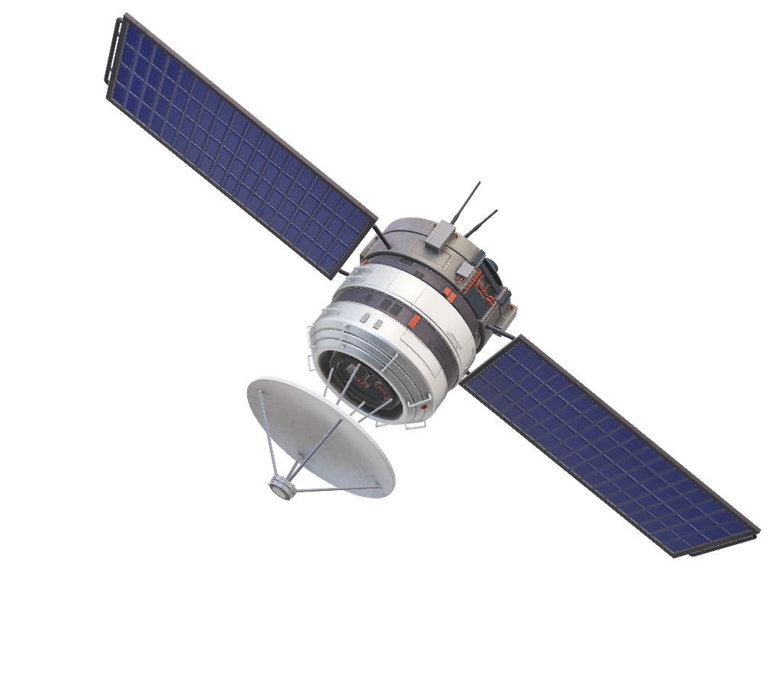
The Need for Estimation

Slide 9
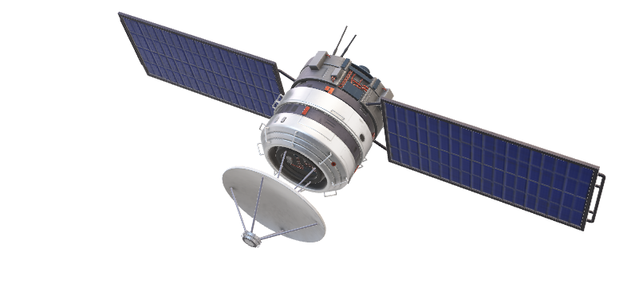

Slide 10
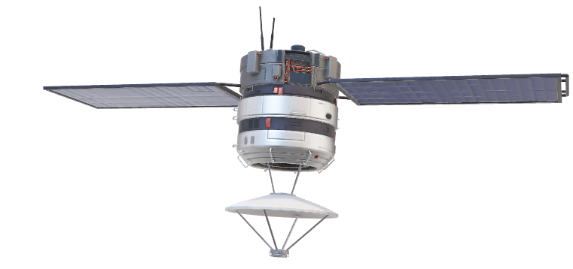

Slide 11
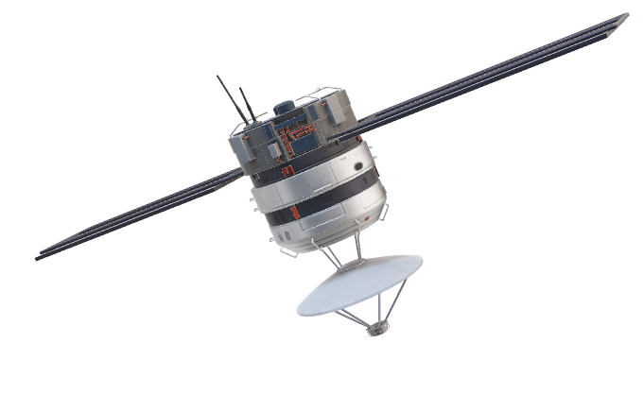

Slide 12
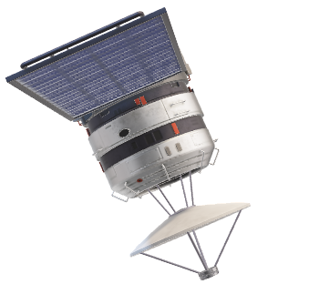

Slide 13


ESTIMATIONS
DATA PREDICTION
DATA FILTERING

Slide 14
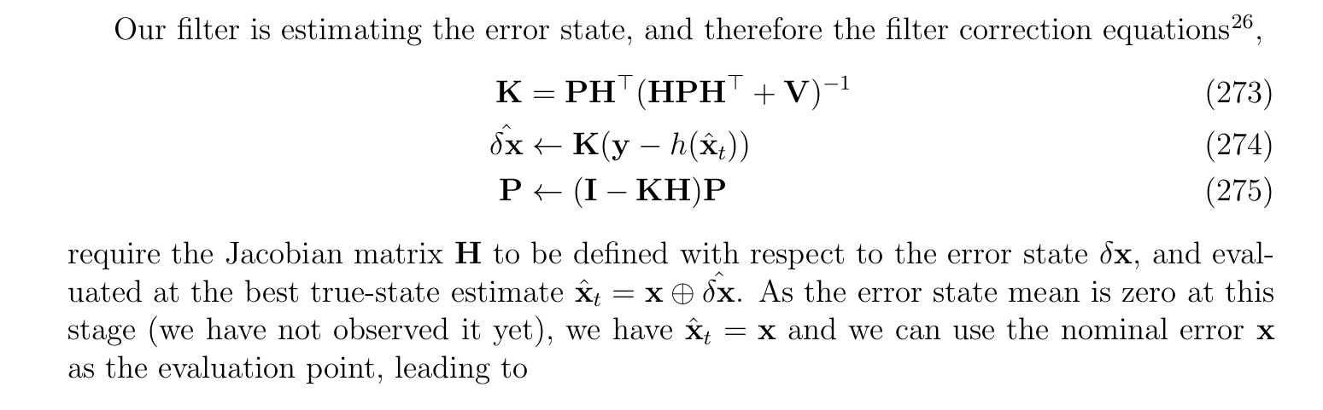

Slide 15
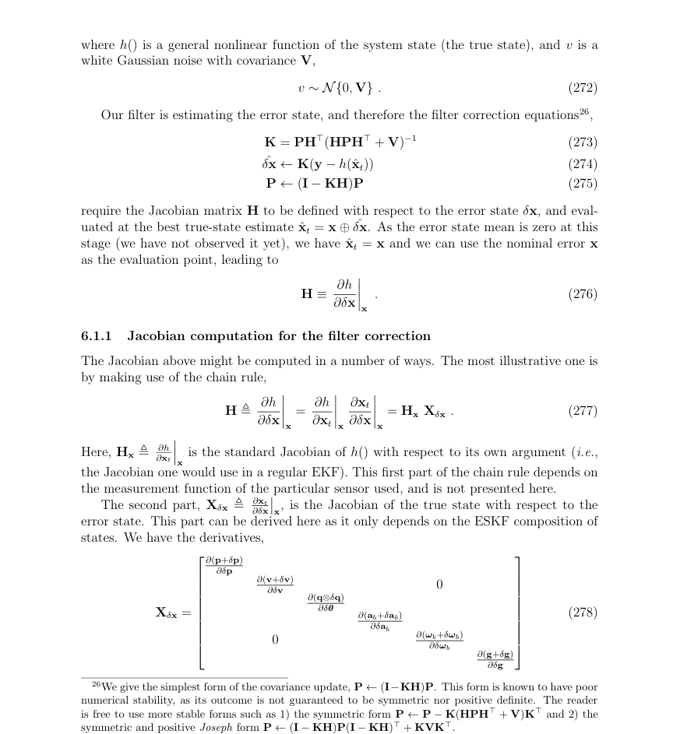
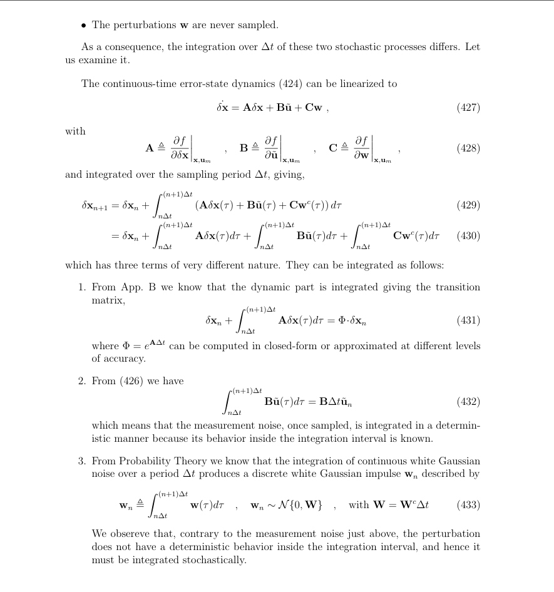

Slide 16
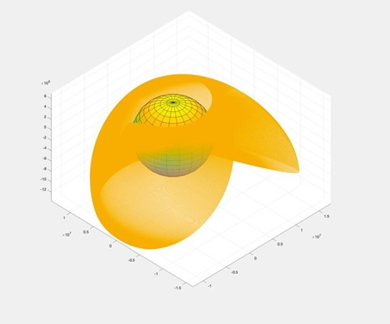
NAVIGATION
ORBIT PROPAGATION
ORBITAL MODES

Slide 17
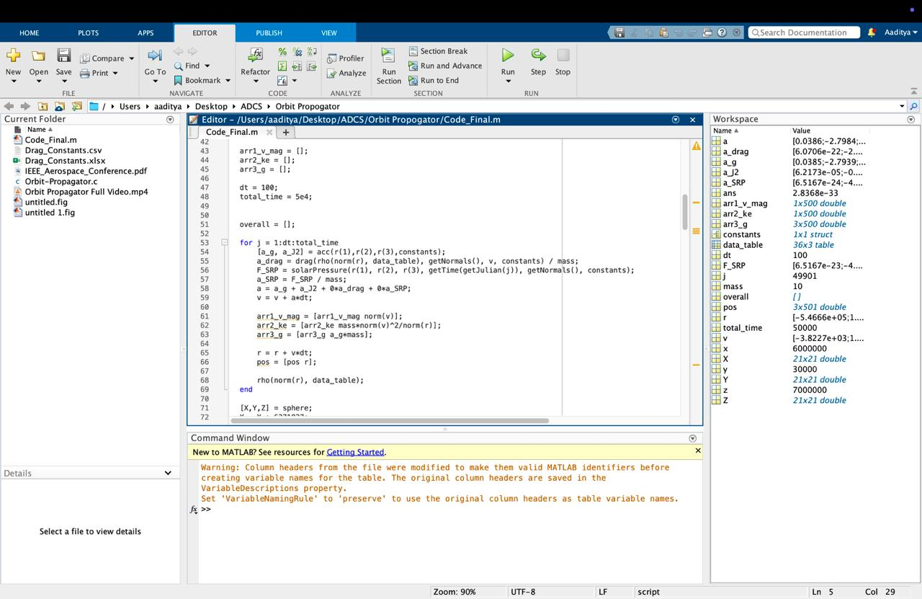

Slide 18
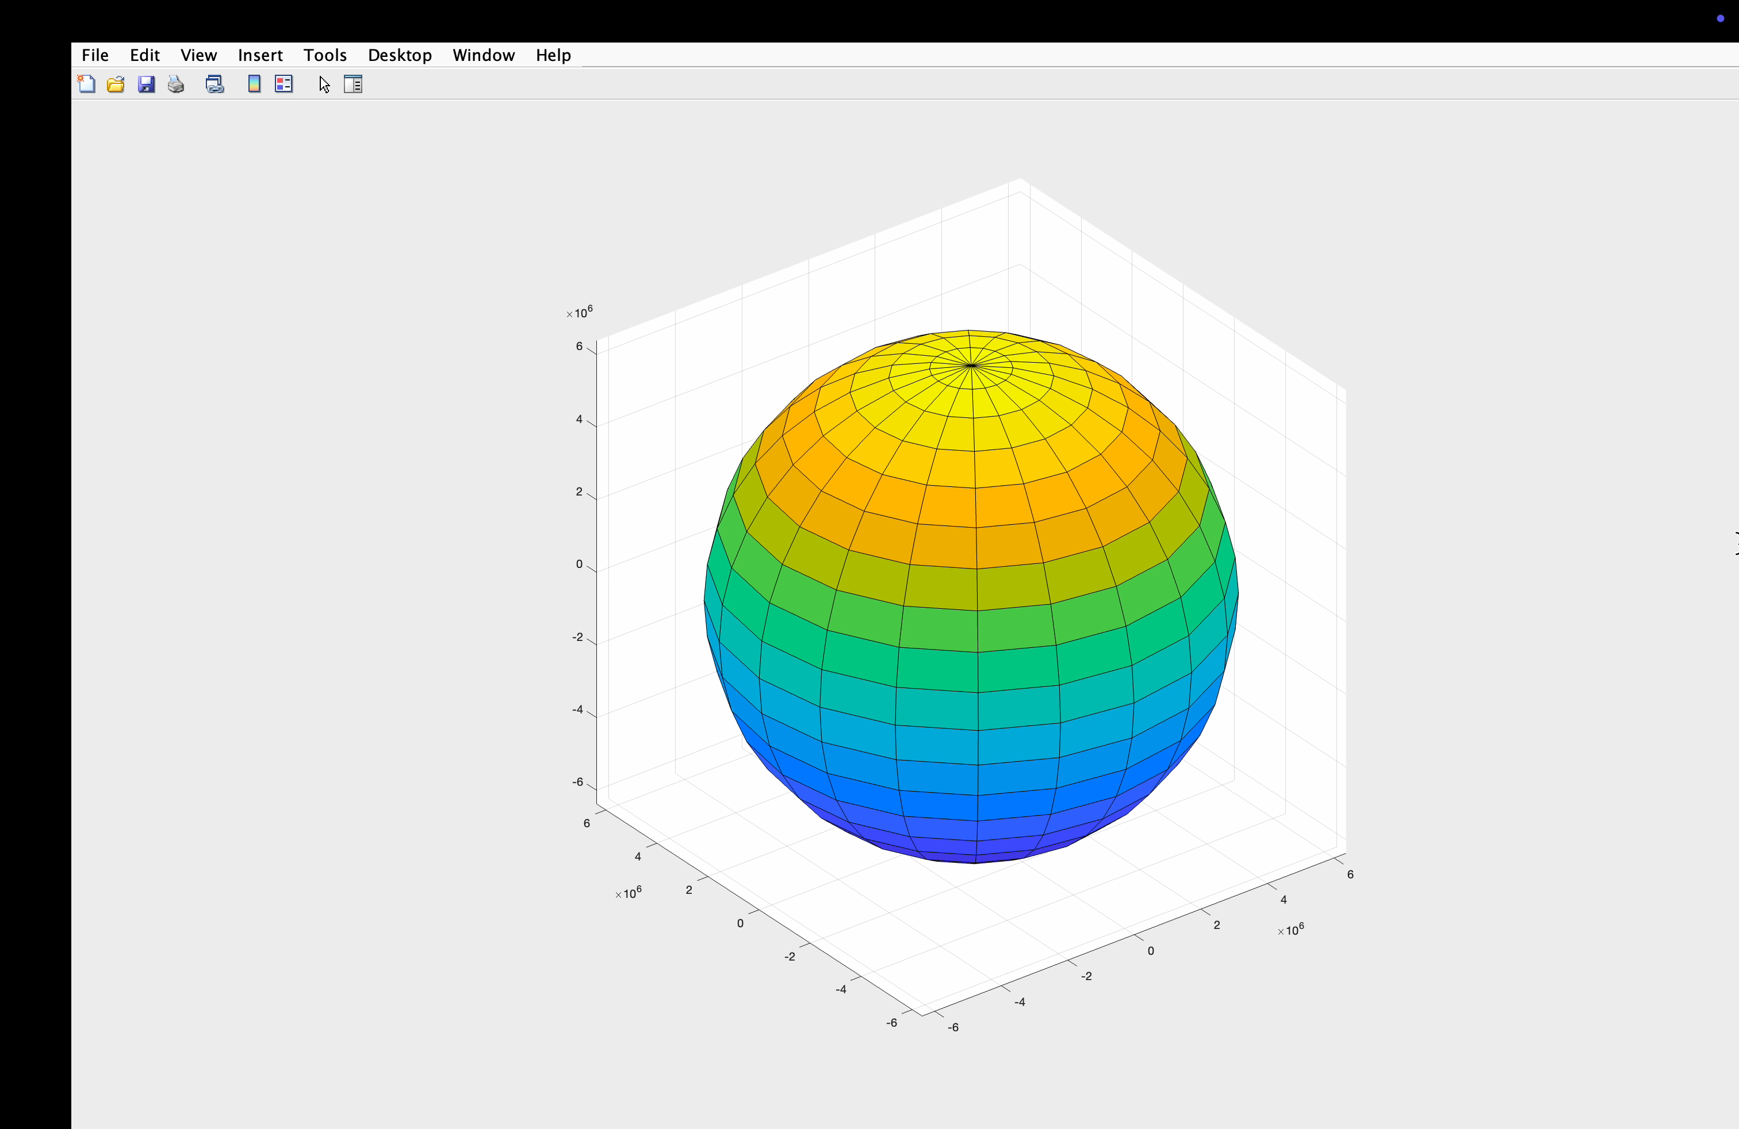

Slide 19
CONTROL SYSTEMS
REACTION WHEELS
MAGNETOTORQUERS

Slide 20
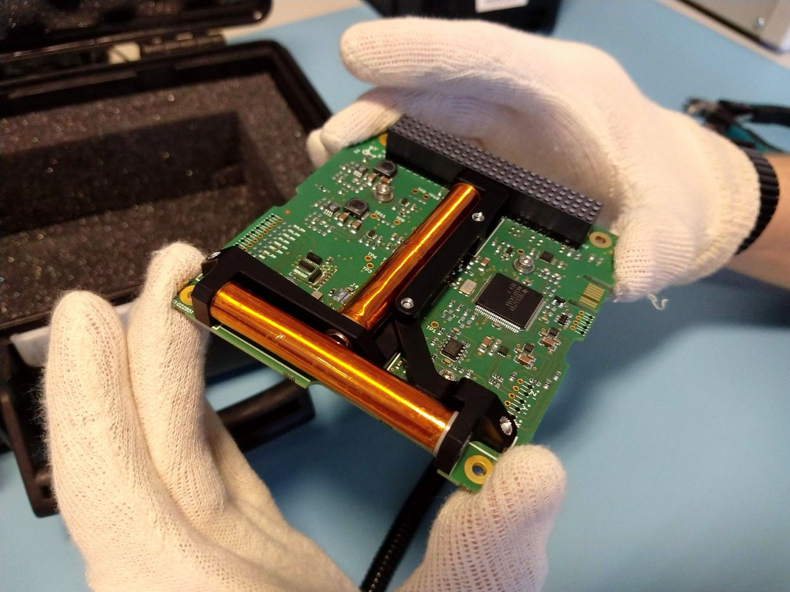
MAGNETORQUERS

Slide 21
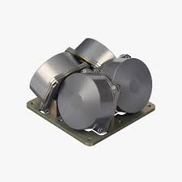
REACTION WHEELS

Slide 22
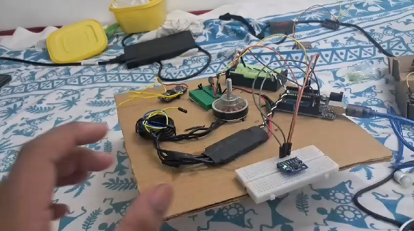
REACTION WHEELS

Slide 23
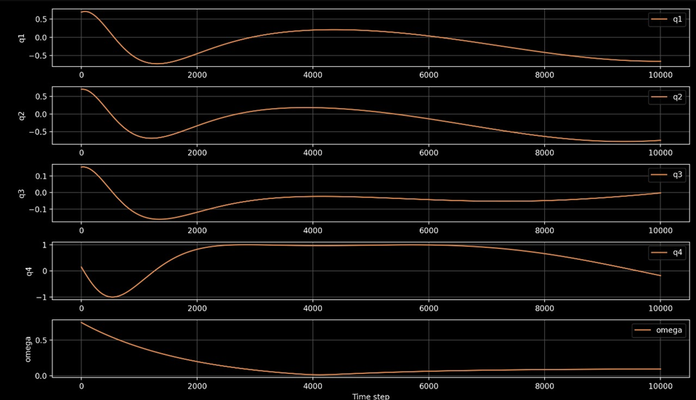
CONTROL

